Slide 1
Category review: Chips
August 2023
Retail Analytics
Brand note: If client logo is not required, use alternate title page layout right click slide thumbnail > Layout > Title

Slide 2
Notes:
To view Privacy video explaining how important data privacy is to Quantium, please click here: https://www.youtube.com/watch?v=Zq1QDAkoRzU
or here Q:\Company Reference\Brand & Design\Brand videos\Q Privacy.mp4
At Quantium, we believe that data is the behavioural footprint of humanity and that it has to be treated with the utmost care and responsibility.
Histories, attitudes, indeed lives are stored within it in ways that aren’t always apparent – and that’s what makes its potential so powerful.
To work with it responsibly, sensitively, we set ourselves the highest data privacy protection and governance standards.
We have spent 17 years perfecting privacy-by-design and secure-by-design principles. Central to this is not holding any personally identifiable information about people –
we neither receive it, and put the necessary protections in place to be unable to decipher it.
Every aspect of handling data is safeguarded: from its de-identification, to its encryption – data security is paramount and of the highest grade.
We pride ourselves on gaining the trust of iconic organisations around the world through years of securely working with their data,
and in turn the trust that builds with their stakeholders.

Slide 3
Executive summary
01
Chips Category Review
We should focus on selling Kettle and Smiths products, products with “Salt”, “Cheese” and “Sour Cream” flavors and products with package size 175g, 150g and 134g.
Stores should prepare enough products to meet shopping needs and have promotions and discounts in the period from December 12th to December 24th.
Should focus on 3 customer groups: Mainstream Young Singles/Couples, Mainstream Retirees and Budget Older Families. Mainstream Young Singles/Couples group can be further targeted for more advertisements/recommendations/promotions on certain brands to encourage more purchase and purchasing slightly more expensive chips brands. Mainstream Retirees group has the same general strategy except to promote cheaper brands to them. And need a strategy to attract more customers in the Budget Older Families.
02
Store Analysis
We should maintain the products layouts in the trial store 86 and 88. and apply products layouts in trial store 88 to trial store 77.

Slide 4
01
Chips Category Review

Slide 5
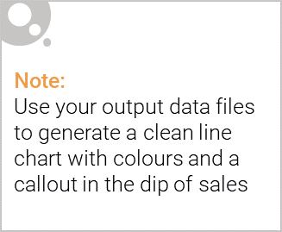
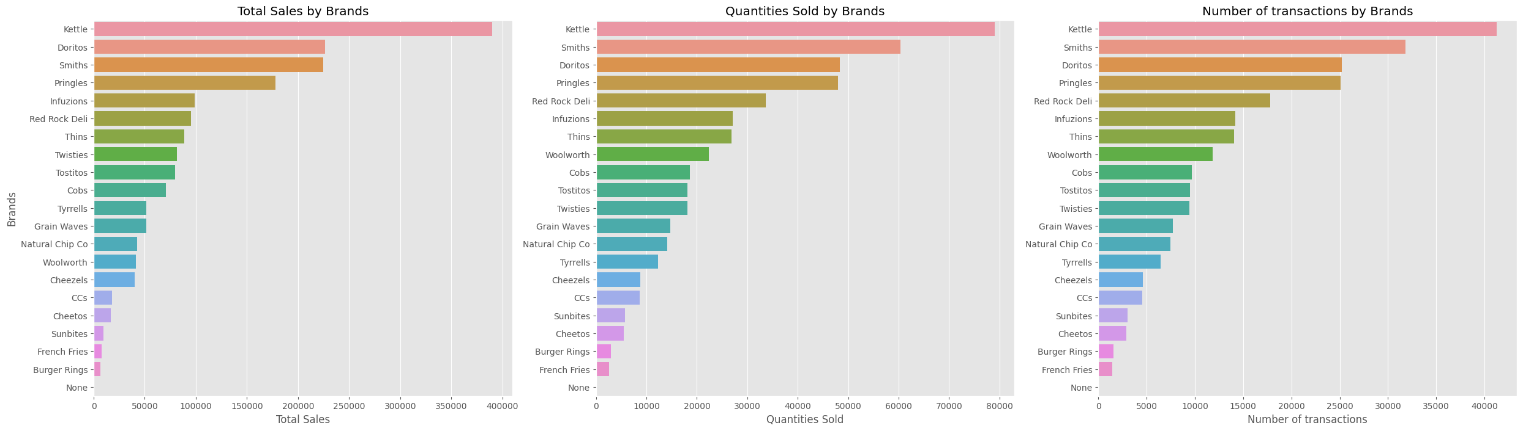
1. We should focus on selling Kettle and Smiths products, products with “Salt”, “Cheese” and “Sour Cream” flavors and products with package size 175g, 150g and 134g.
Should focus on selling Kettle and Smiths products:
Kettle and Smiths are the brands with the highest Total sales, Quantities sold and number of transactions.

Slide 6
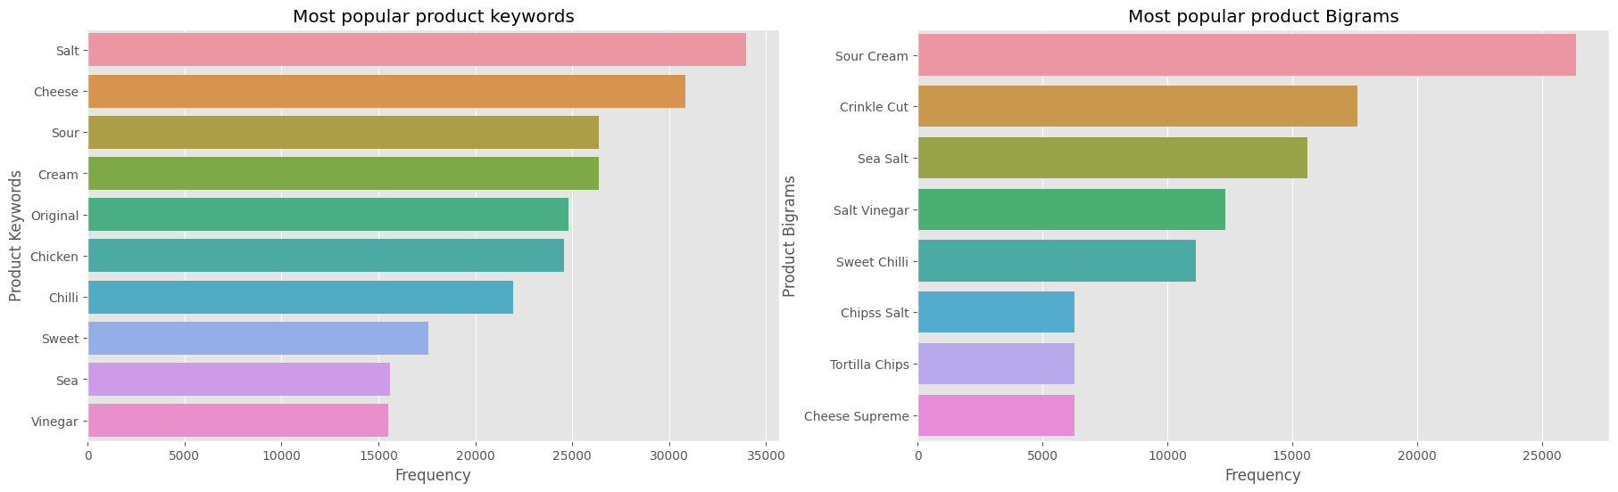
1. We should focus on selling Kettle and Smiths products, products with “Salt”, “Cheese” and “Sour Cream” flavors and products with package size 175g, 150g and 134g.
Should focus on selling products with “Salt”, “Cheese” and “Sour Cream”:
“Salt”, “Cheese” and “Sour Cream” are the most popular keywords in product names. So customers tend to buy products that taste like Salt, Cheese and Sour Cream.

Slide 7
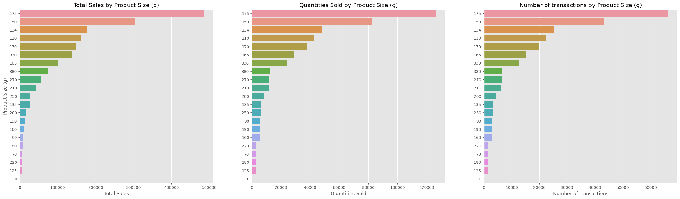
1. We should focus on selling Kettle and Smiths products, products with “Salt”, “Cheese” and “Sour Cream” flavors and products with package size 175g, 150g and 134g.
Should focus on selling products with package size 175g, 150g and 134g:
175g, 150g and 134g are package sizes with highest Total sales, Quantities sold and number of transactions.

Slide 8
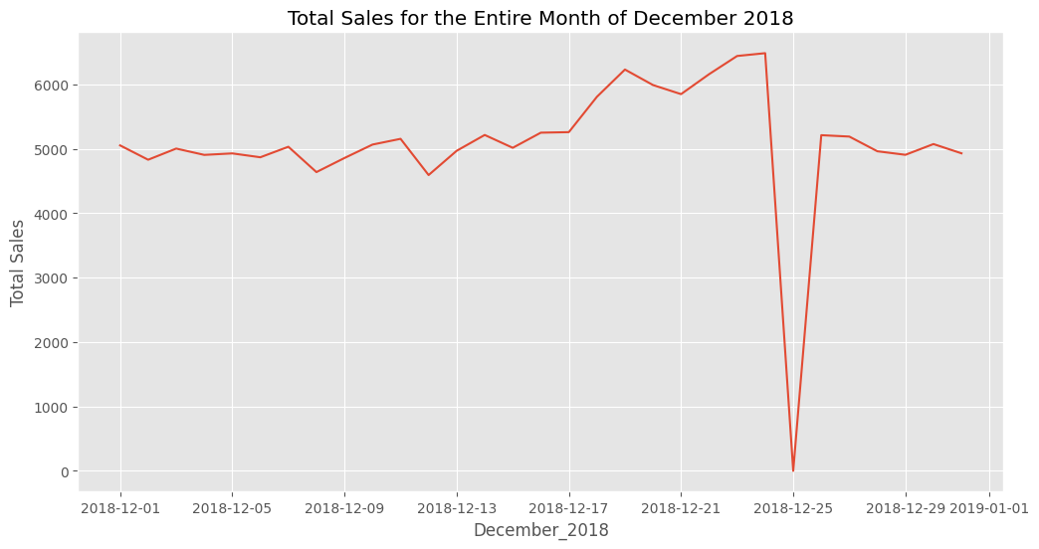
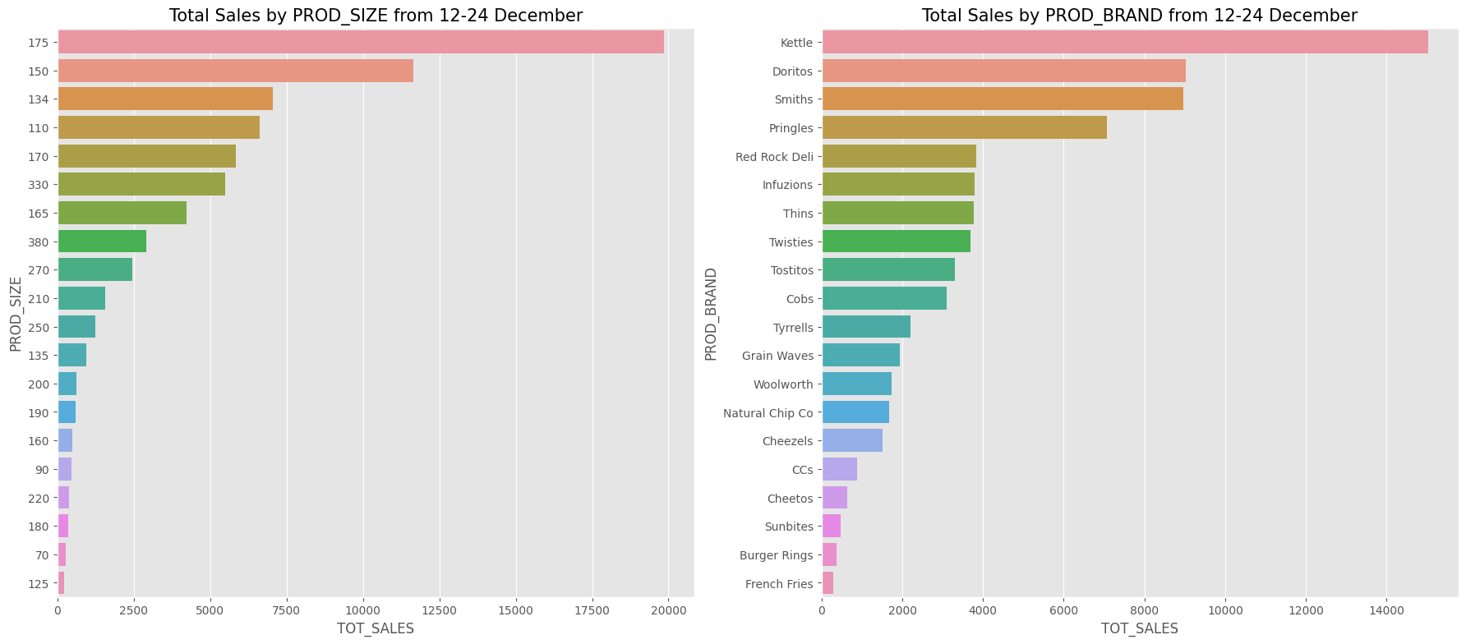
2. Stores should prepare enough products to meet shopping needs and have promotions and discounts in the period from 12th December to 24th December.
Total sales increase before Christmas Day, start from 12th December to 24th December, which make sense because people tend to purchase food items more when approaching holiday seasons.
During the preparation period for Christmas Day, customers bought the most products with a size of 175g.
Kettle was the highest-selling brand during holiday season.

Slide 9
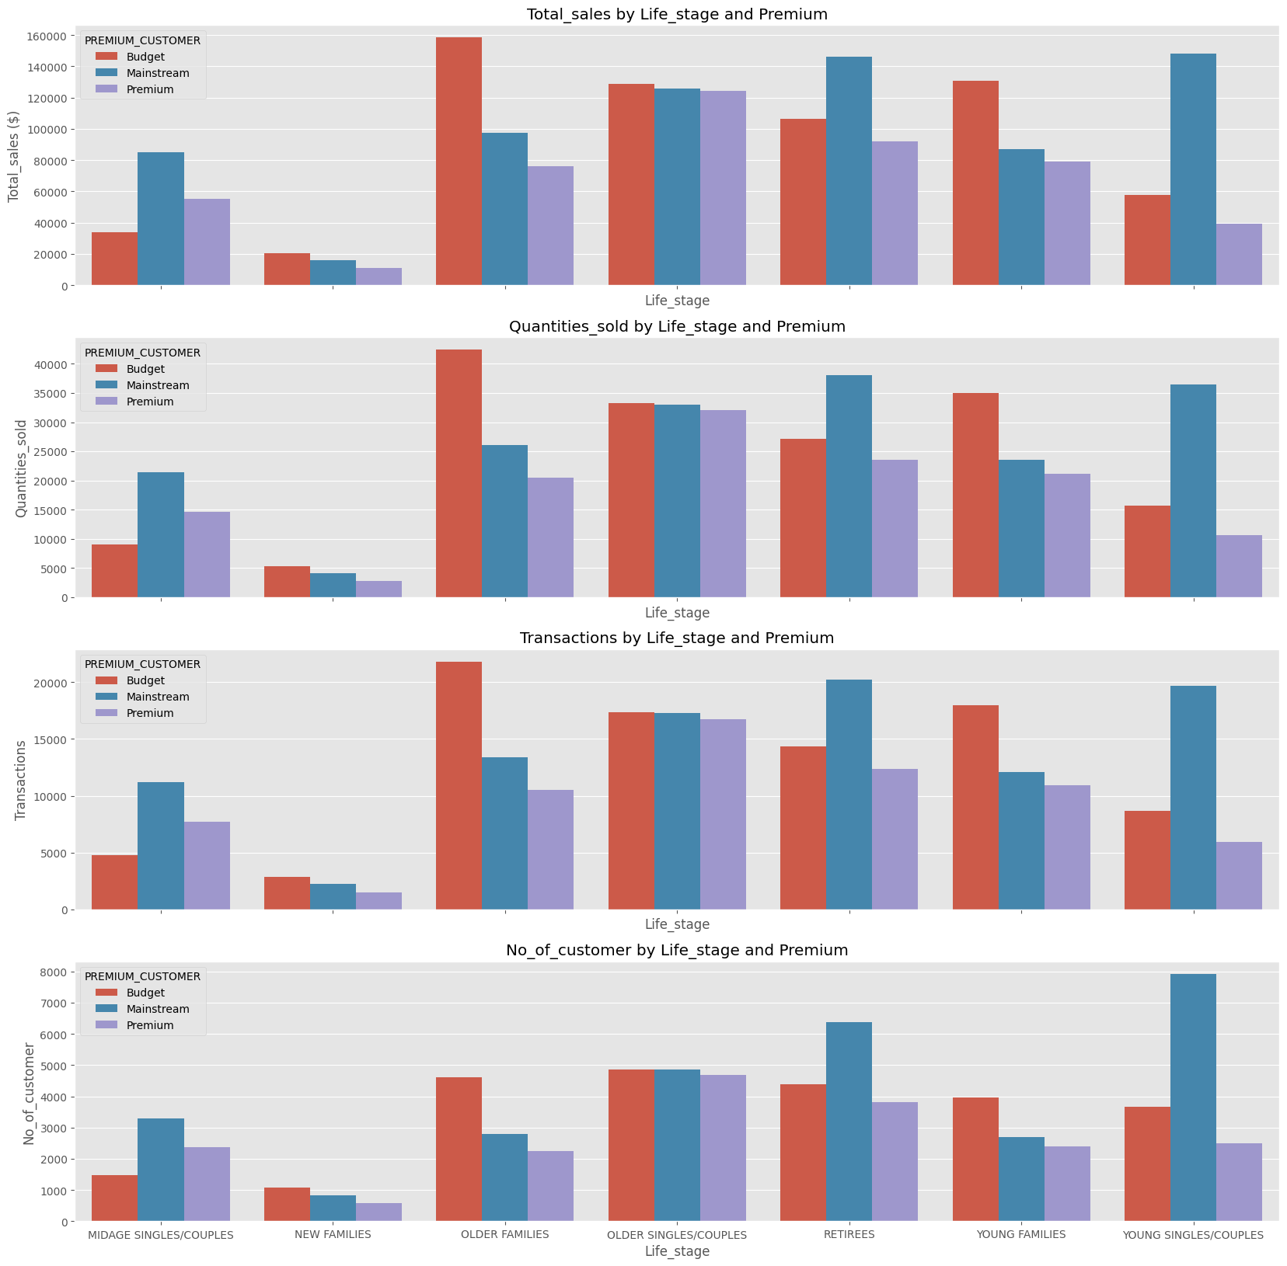
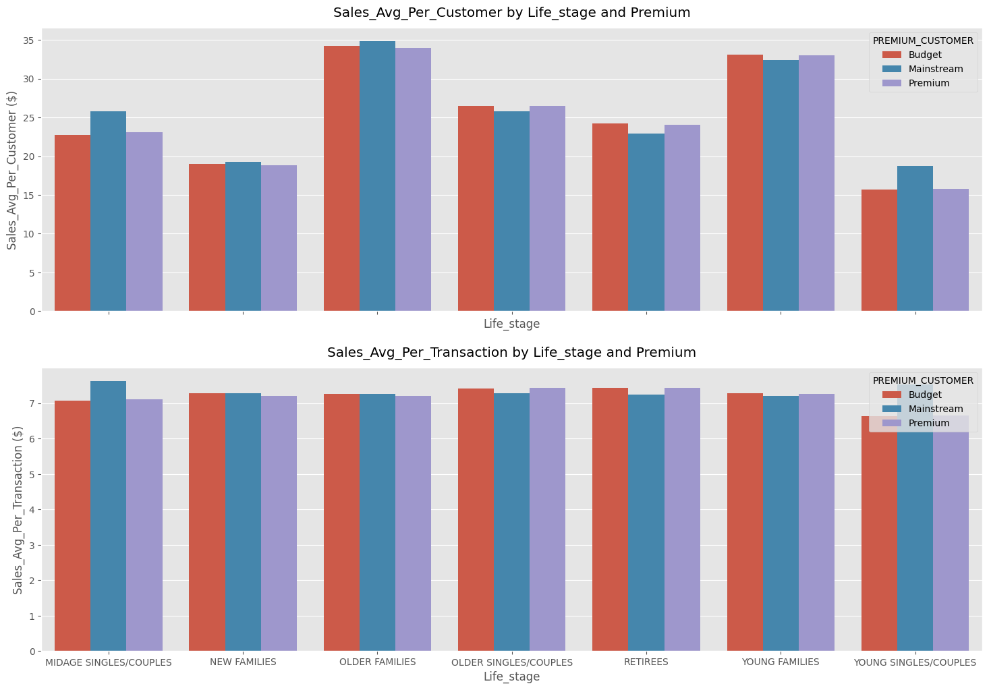
3. Should focus on 3 customer groups: Mainstream Young Singles/Couples, Mainstream Retirees and Budget Older Families. Mainstream Young Singles/Couples group can be further targeted for more advertisements, recommendations and promotions on certain brands to encourage more purchase and purchasing slightly more expensive chips brands. Mainstream Retirees group has the same general strategy except to promote cheaper brands to them. And need a strategy to attract more customers in the Budget Older Families.

Slide 10
3 customer groups: Mainstream Young Singles/Couples, Mainstream Retirees and Budget Older Families contributed to the most sales, have the largest number of customers.
Mainstream Young Singles/Couples has highest price_unit_avg but tend to purchase lower quantities chips. This group is also more willing to pay per package of chips, compare to their Budget and Premium counterparts.
Mainstream Retirees has the lower price_unit_avg but tend to purchase more quantities chips.
Budget Older Families tends to buy lots of chips, but there are not as much of them in the customers base

Slide 11
02
Trial store performance

Slide 12
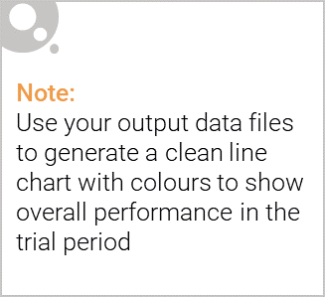
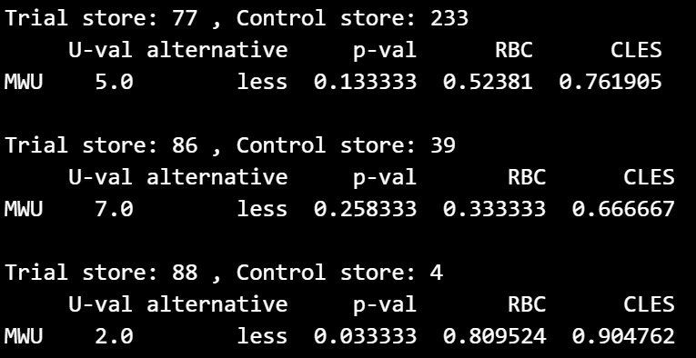
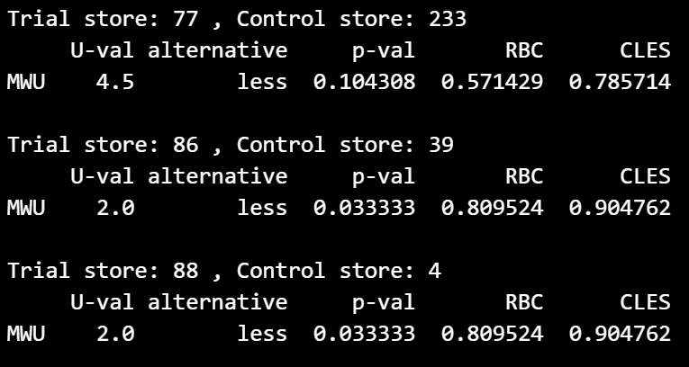
1. We should maintain the products layouts in the trial store 86 and 88. and apply products layouts in trial store 88 to trial store 77.
The results for trial store 88 during the trial period show a significant increase in TOT_SALES and Number_of_Customers.
Trial store 86 during the trial period show a significant increase in Number_of_Customers.
Trial store 77 during the trial period has no significant difference.

